Slide 1

Elisey
Maureen
Systems Architect at Intui Travel
president of Synergy, EPITA's social diversity association
Bonjour! Hallo !
We are the « barman_joke »
worked with DLR on optical free space communication
Vice-President and cofounder of GottaGoHack
Aristide
Mehdi

Slide 2
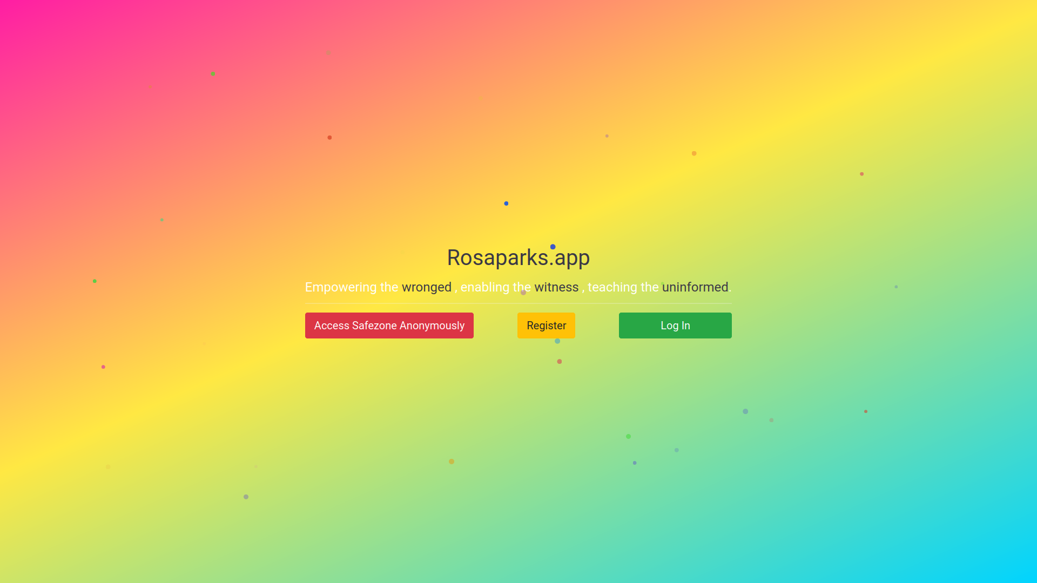

Rosaparks.app
A cocoon for confort and learning
Powered by

Slide 3
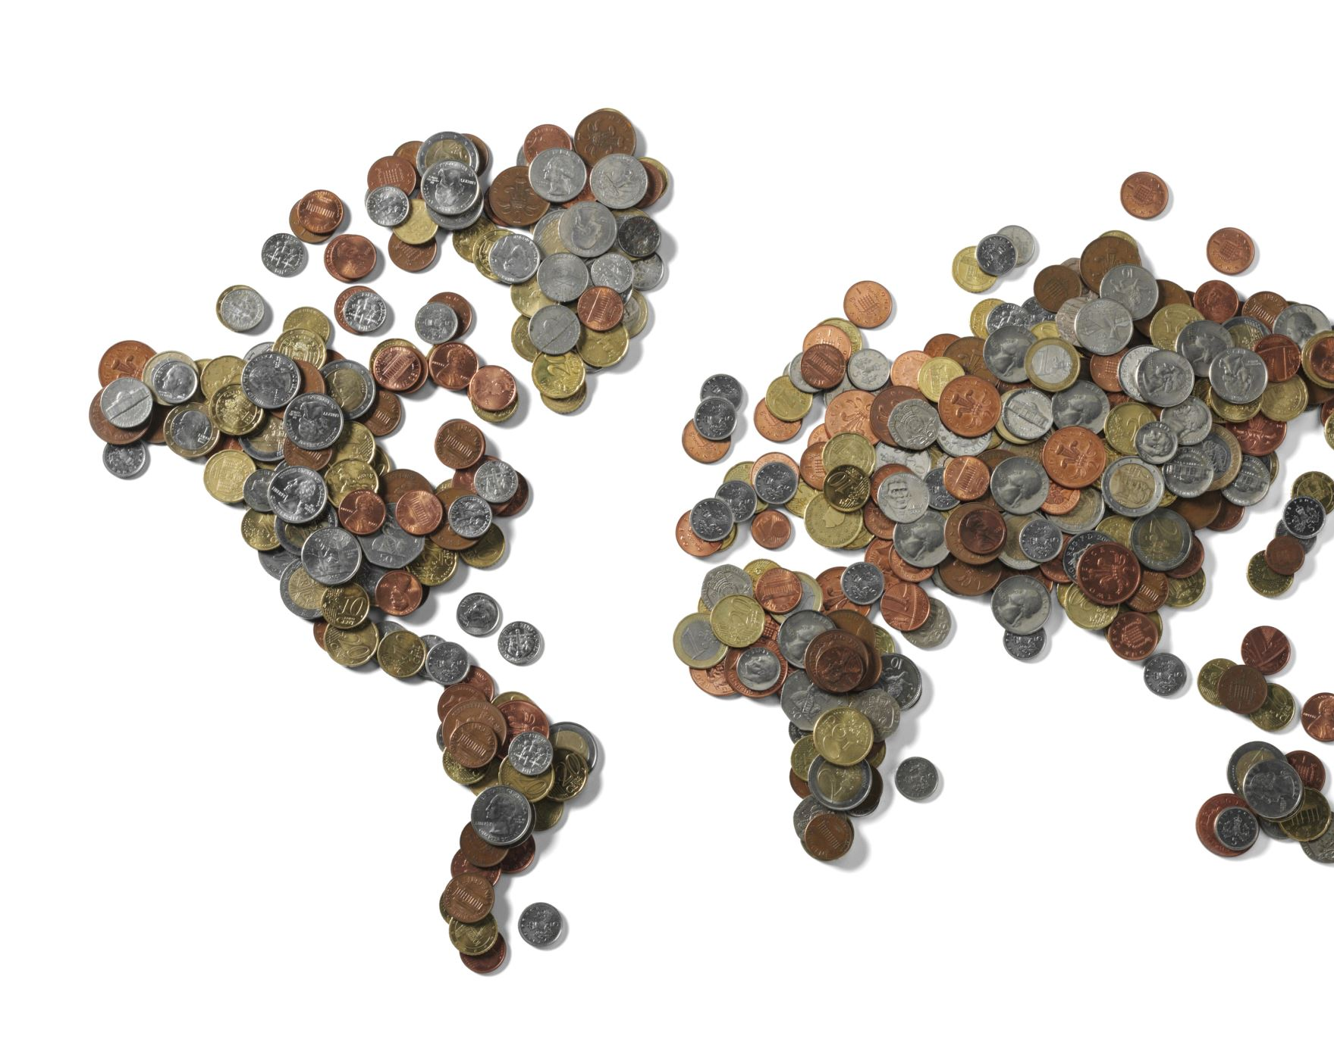
The real problem?
Money.

Slide 4

We bring in more diverse people!
Businesses, NPOs, and individuals

Slide 5
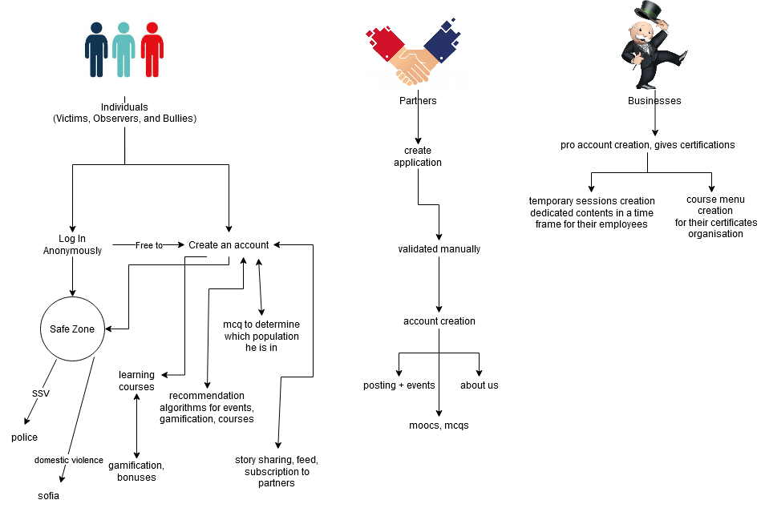

Slide 6
https://rosaparks.app
Let's check it out!
Powered by

Slide 7
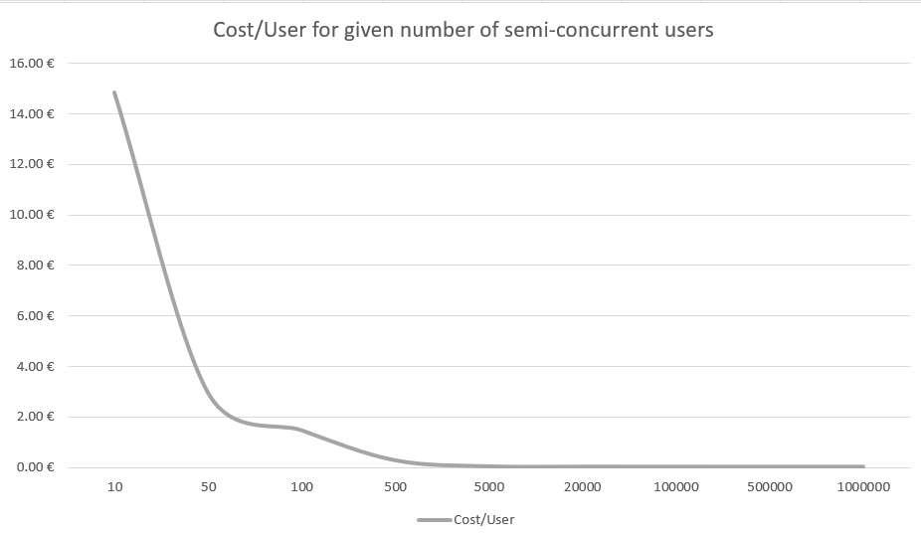
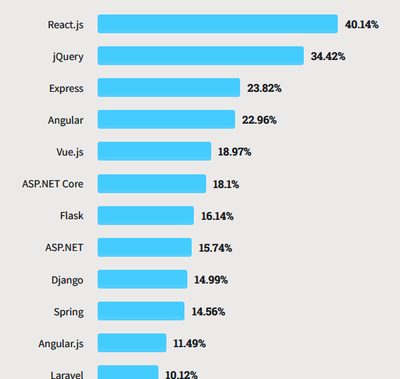
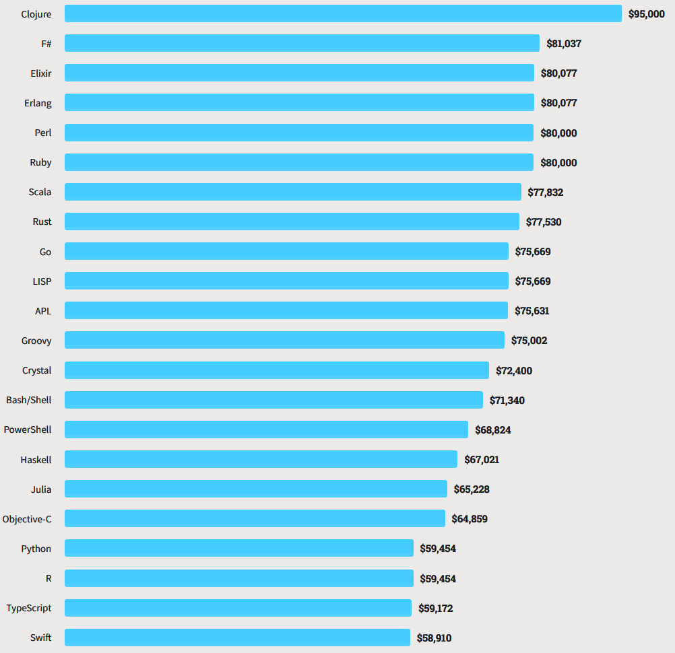
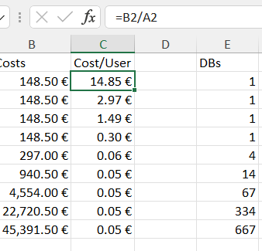
Low costs, only pay for what you use

Slide 8
High revenues
Companies value social diversity ! Intel for example set aside $300 million to manage diversity and inclusion in its workplace, and with countries like France writing new laws around it,
Depending on the country, sensibilisation seminars and courses, even on the web, can get up to 1280 euros in Germany.
https://www.intel.com/content/www/us/en/diversity/diversity-2016-annual-report.html
https://ifm-business.de/firmen/seminare/personalmanagement/anti-rassismus-strategien/
https://www.diversitycampus.eu/en/contact/ (1280€ for online seminar)
https://living-diversity.de/images/PDF_Sexismus-am-Arbeitsplatz-02_2020.pdf (350€ for a person, 420€ for a company)

Slide 9
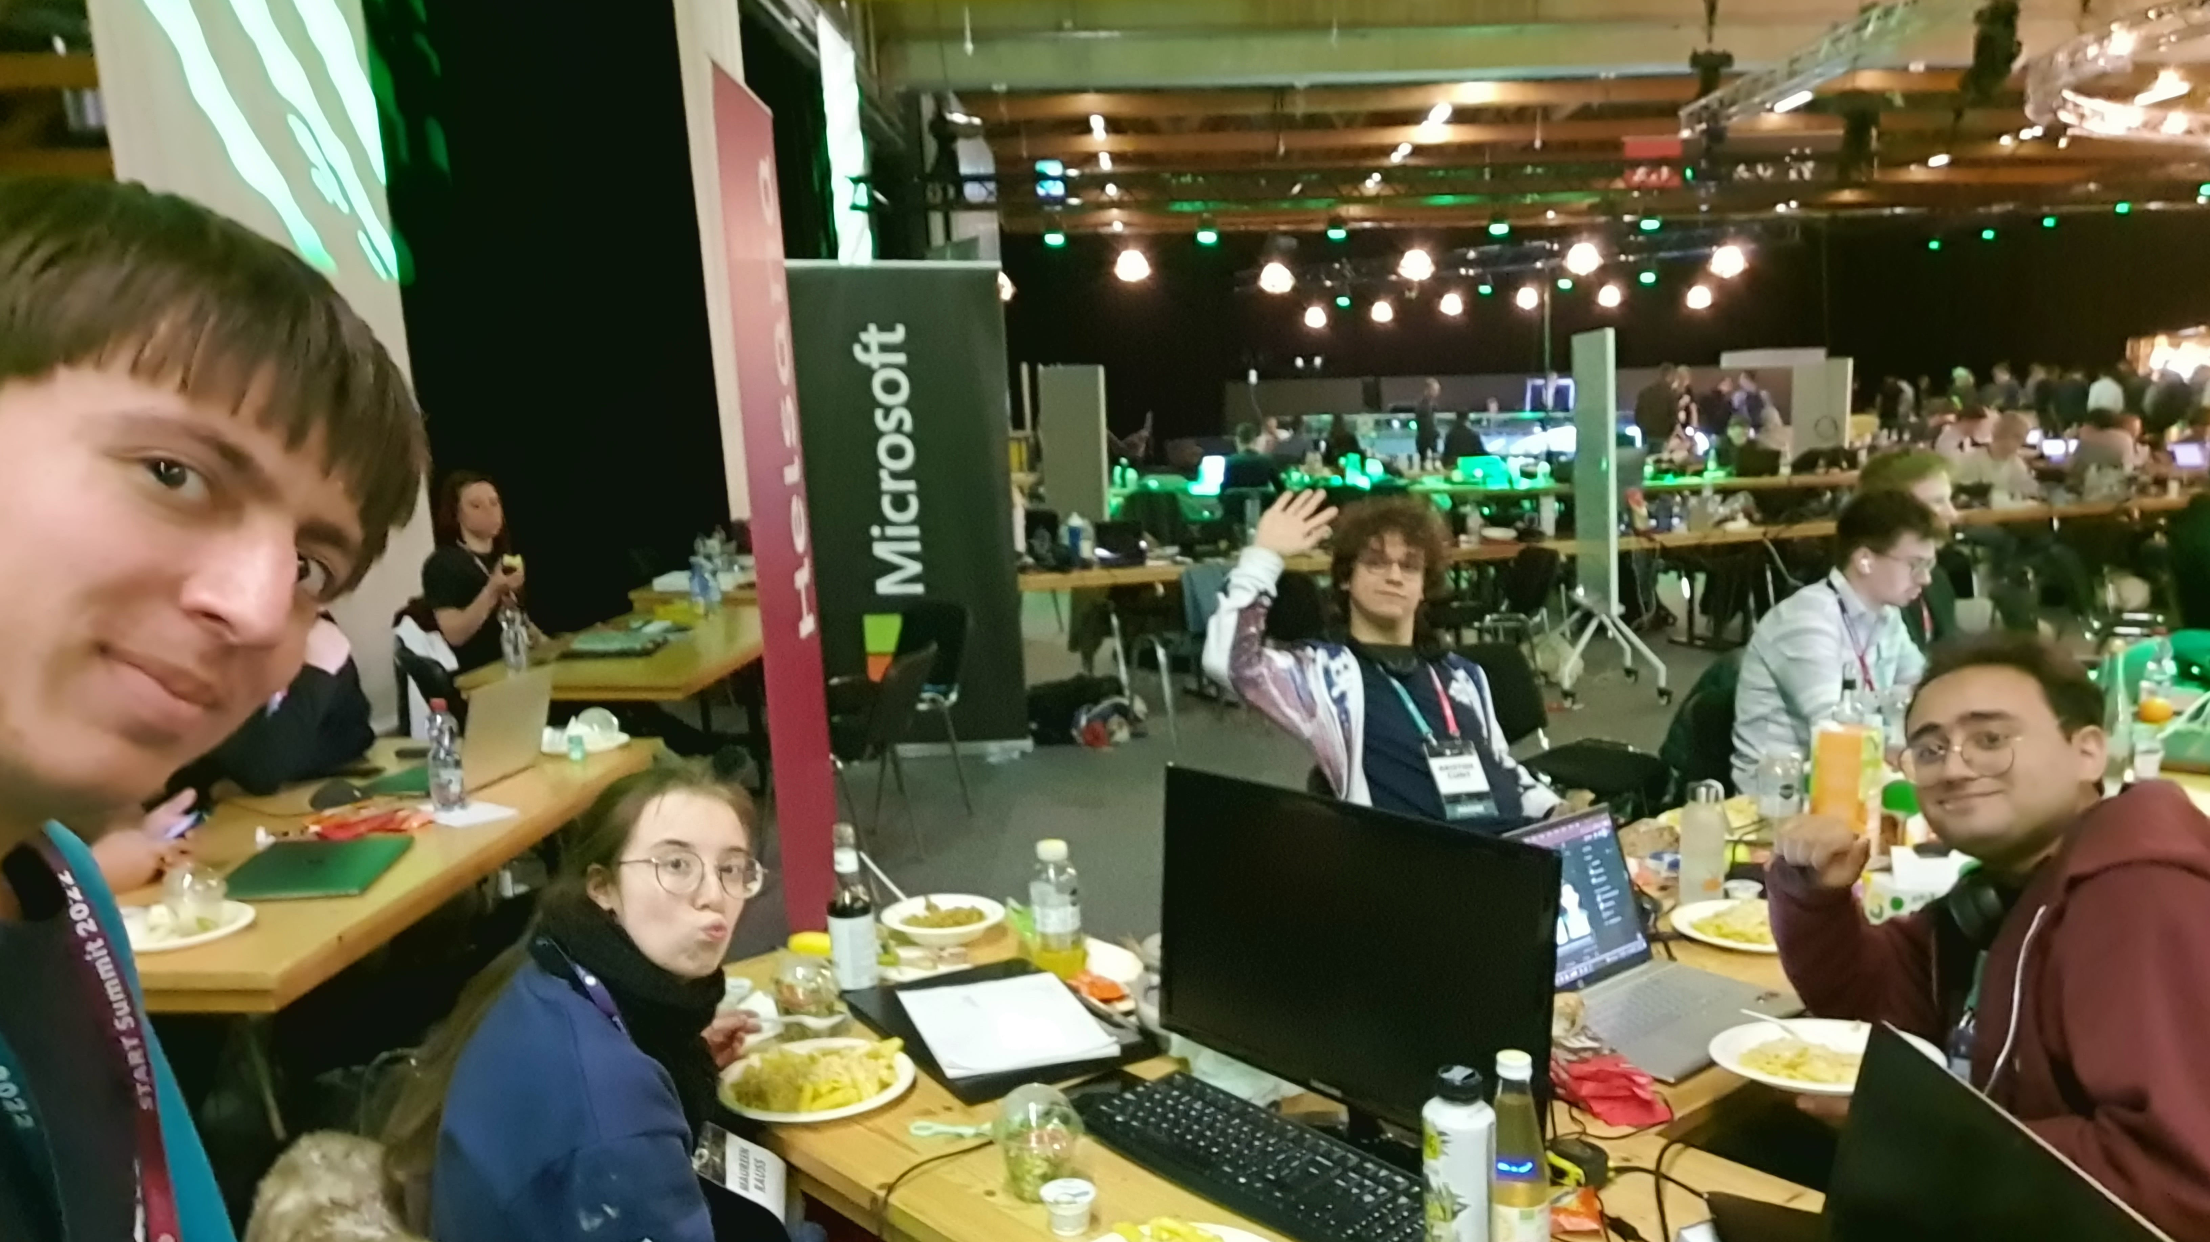
Thanks for the event! You sure know how to run a Hackathon!

